Slide 1
MYSQL CAR SELL PROJECT
GAJANAN RAJULWAR

Slide 2
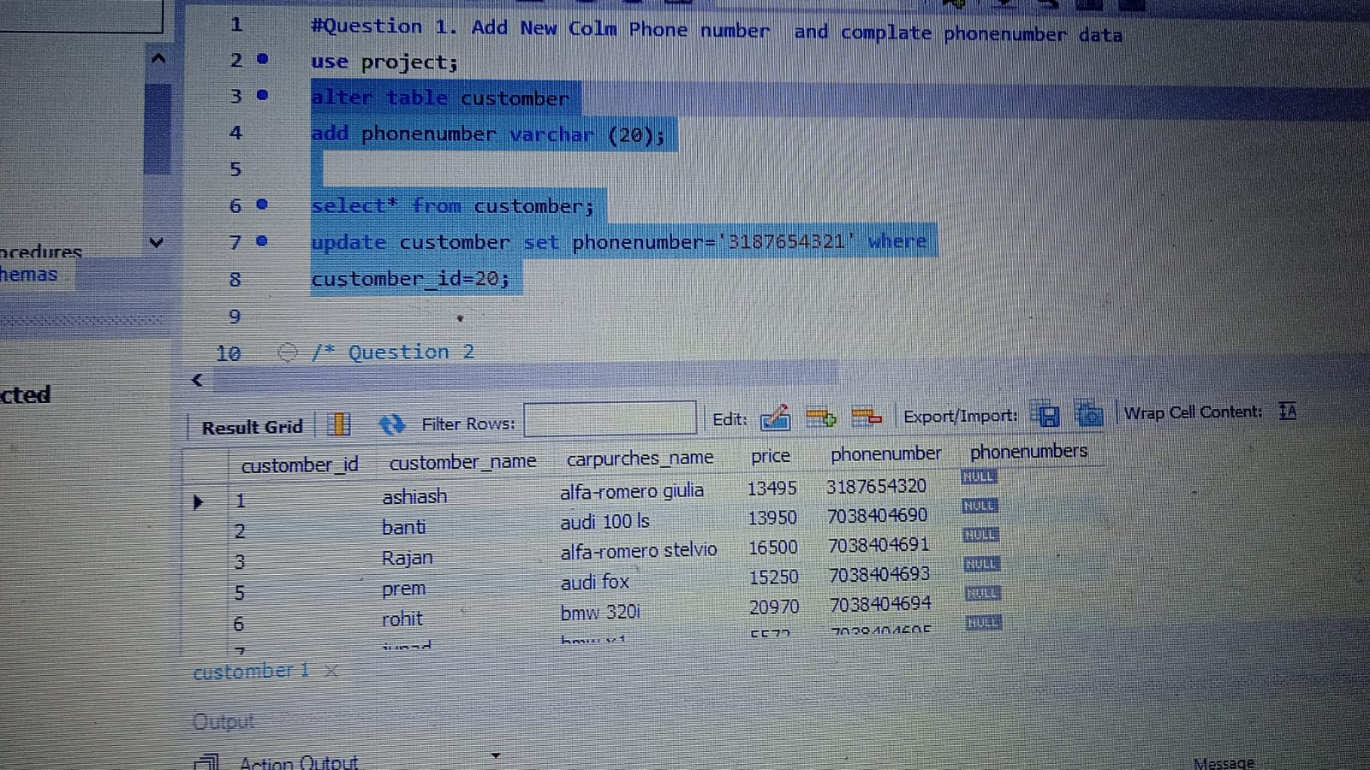
Question 1. Add New Colm Phone number and complate phonenumber data

Slide 3
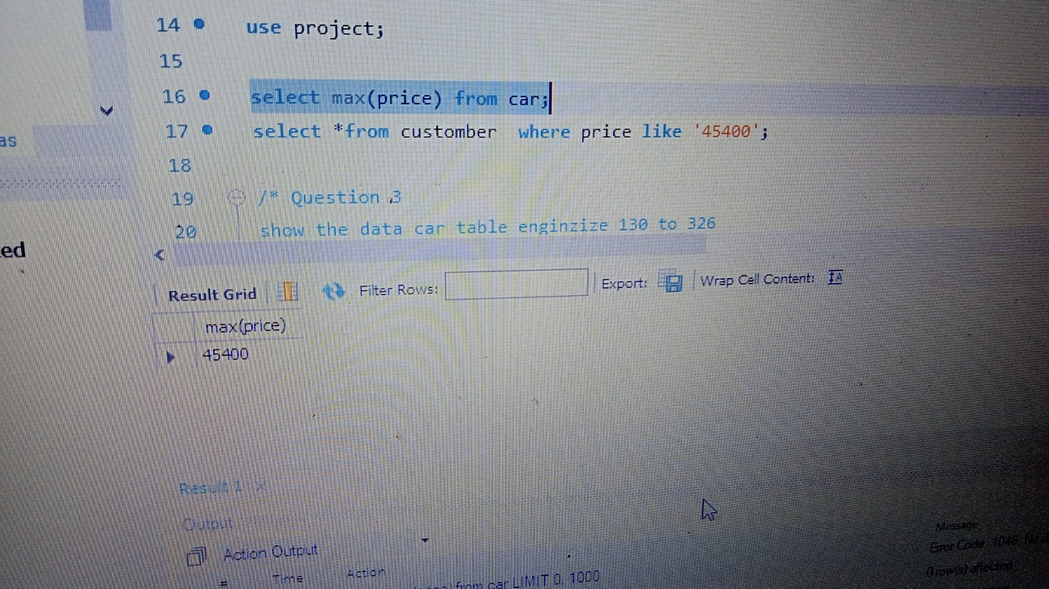
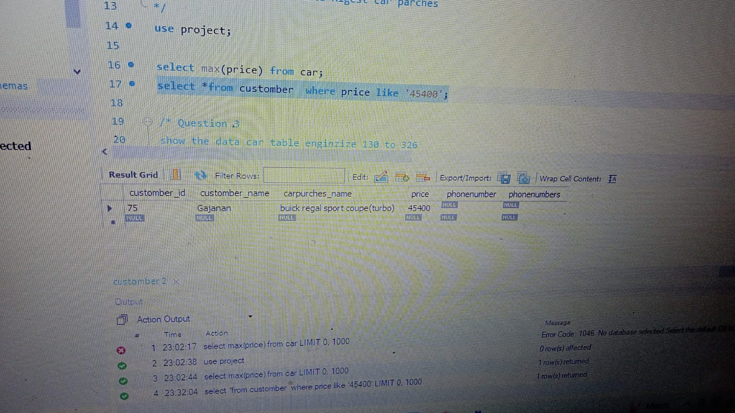
Question 2 show the Highest prise in car and show customber the data Higest car parches

Slide 4
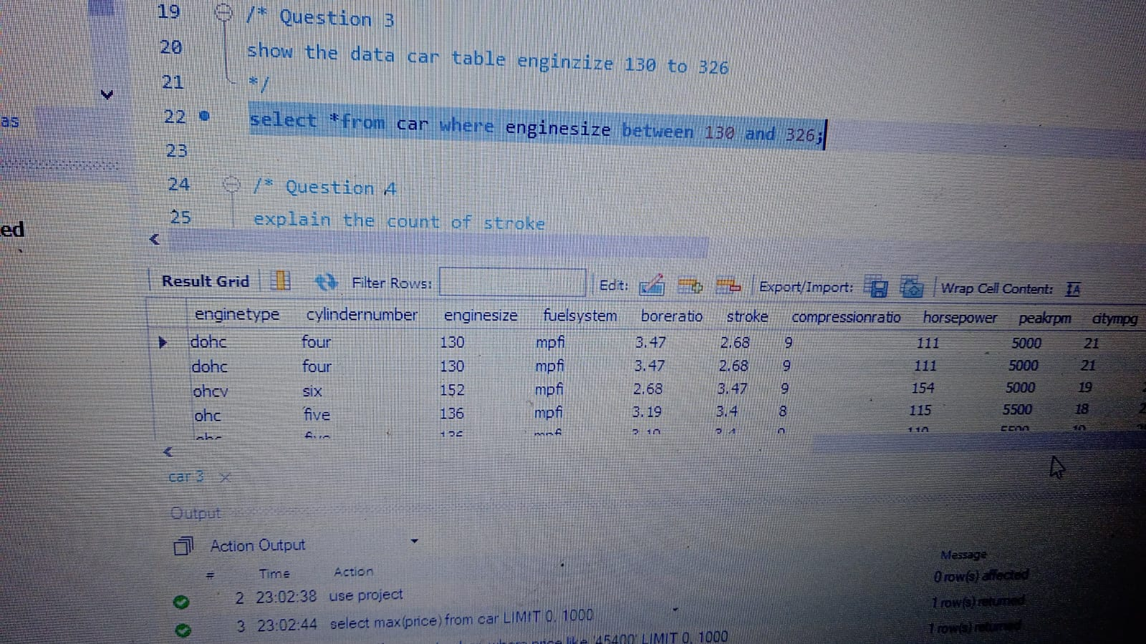
Question 3 show the data car table enginzize 130 to 326

Slide 5
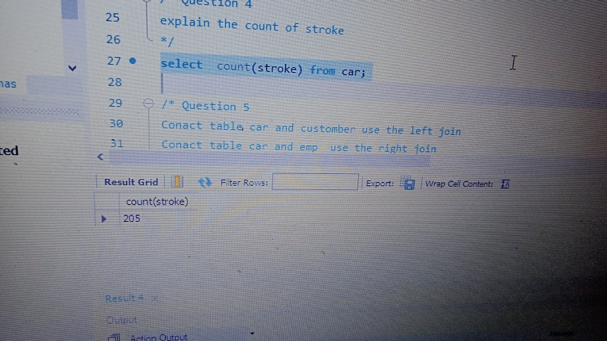
Question 4 explain the count of stroke

Slide 6
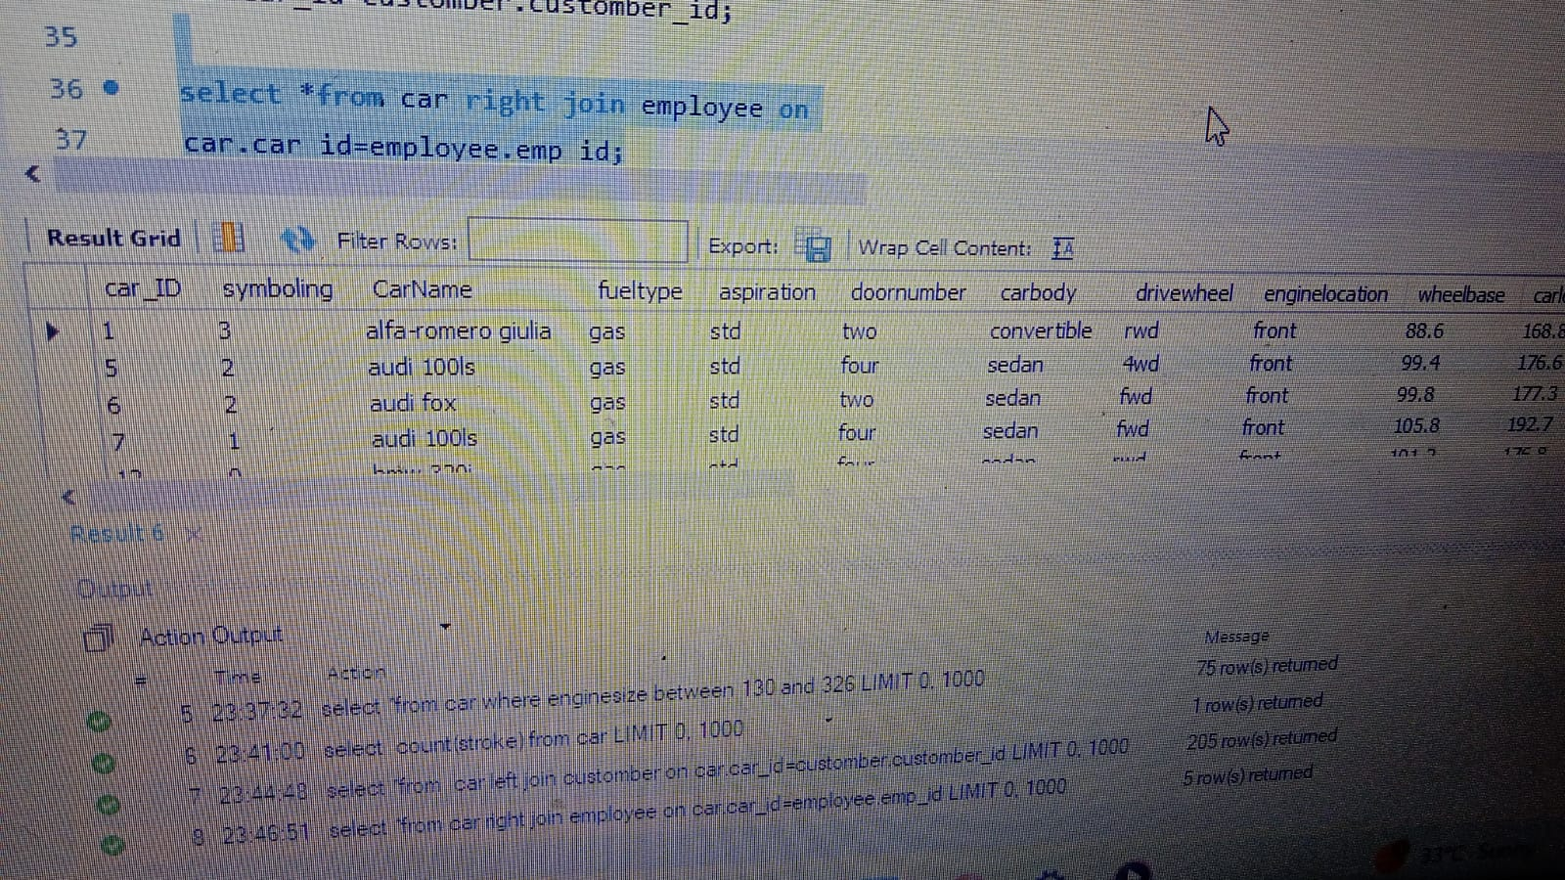
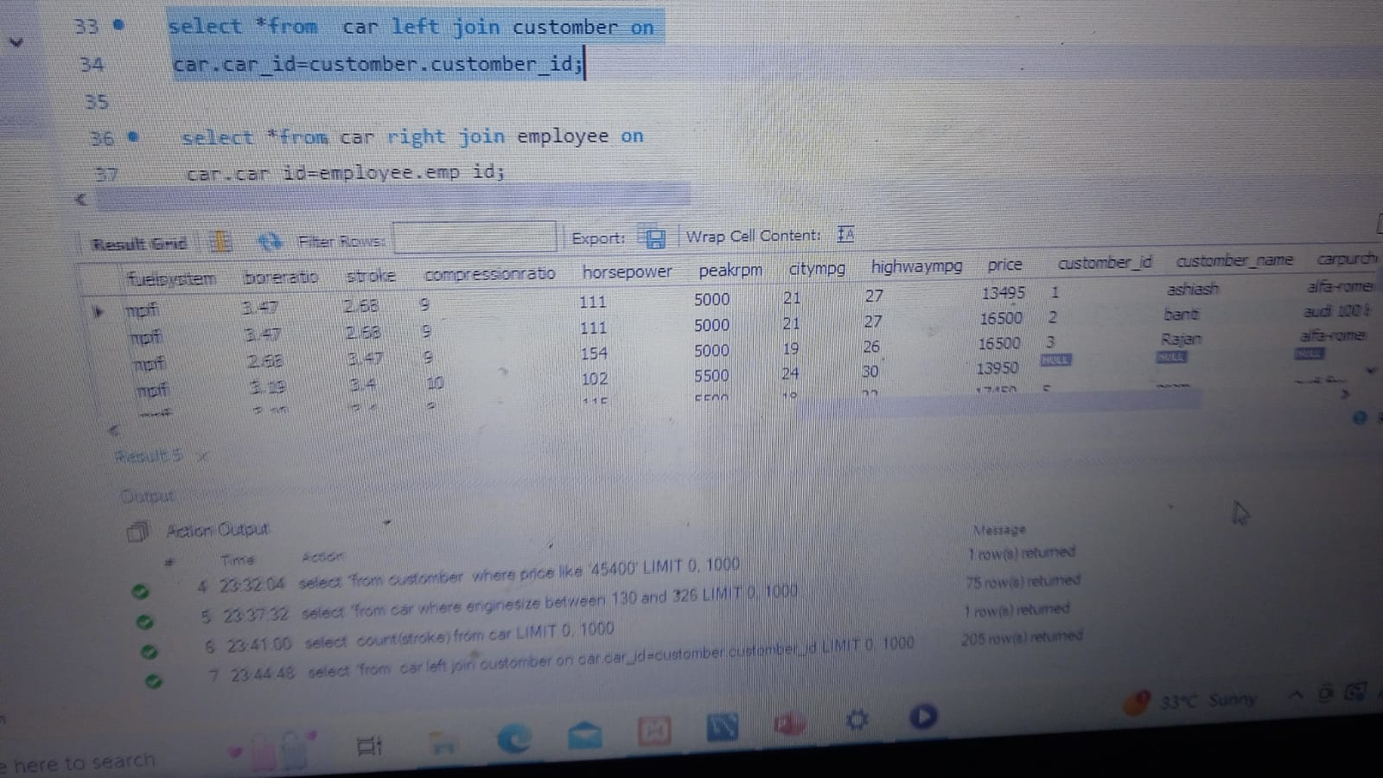
Question 5 Conact table car and customber use the left join
Conact table car and emp use the right join

Slide 7
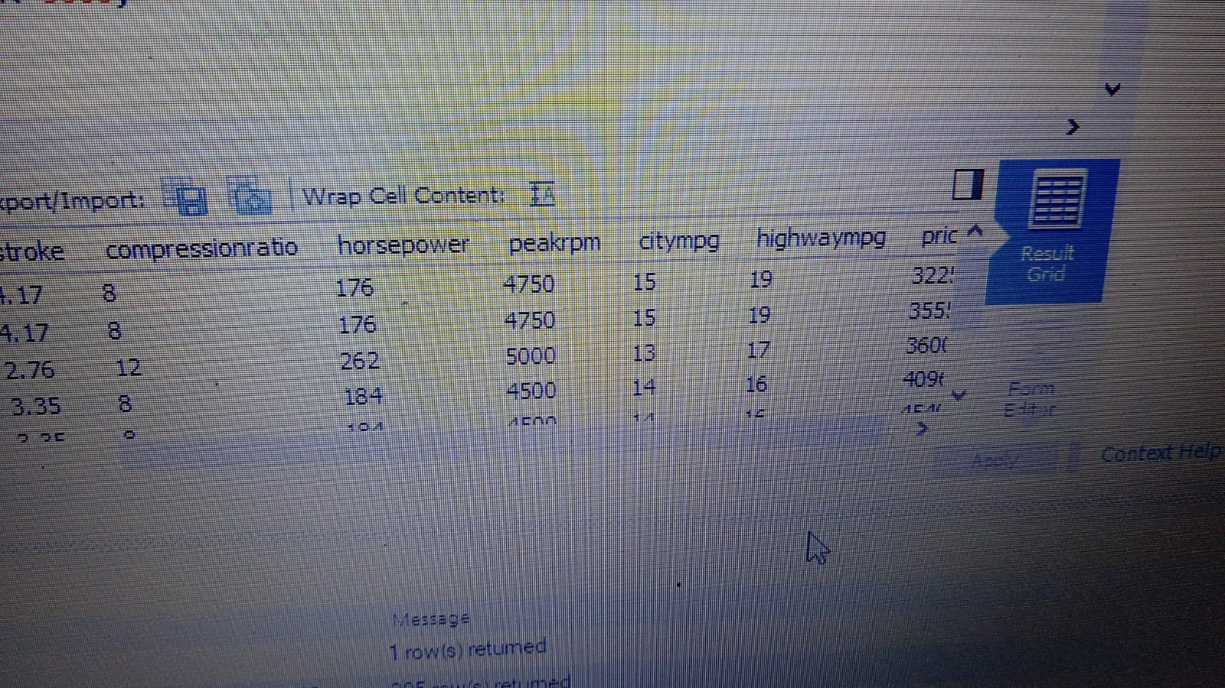
6. Question show the data horsepower 168 power above and peakrpmm 5000 low

Slide 8
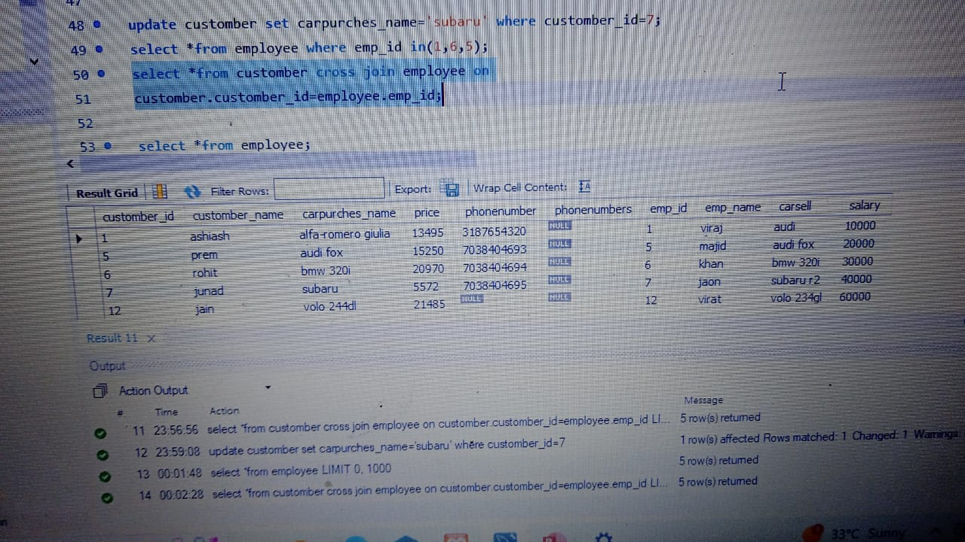
Question 7 show the emploee data emp_id 1,6,5 and emp cell tar car data use right join

Slide 9
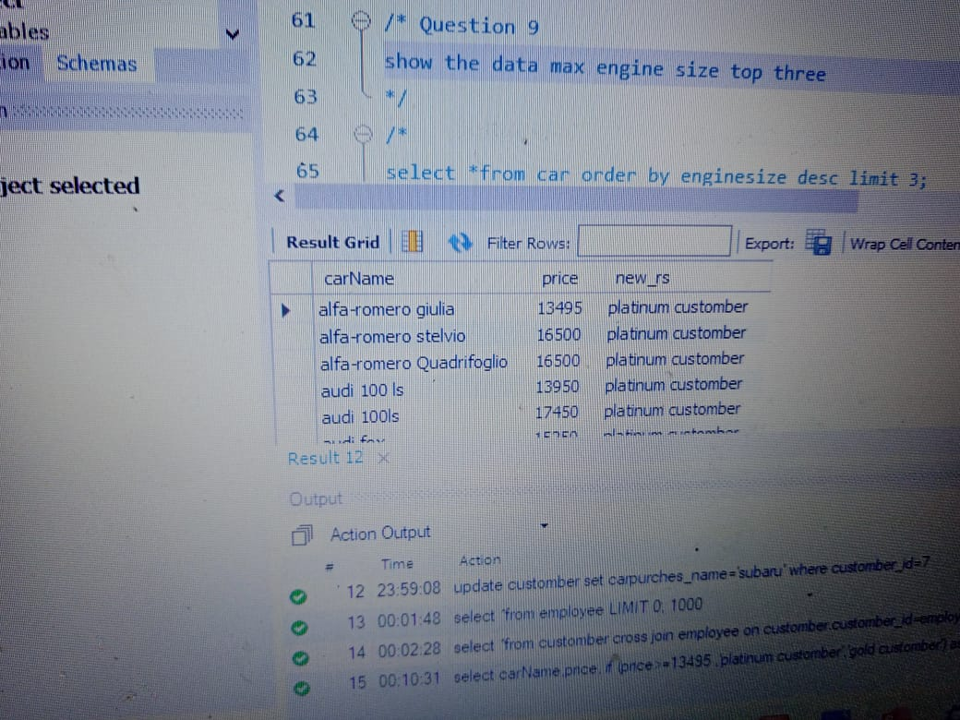
Question 8 select to 2 categrey first platinum and second gold prise start 13495 crete the data if condition use

Slide 10
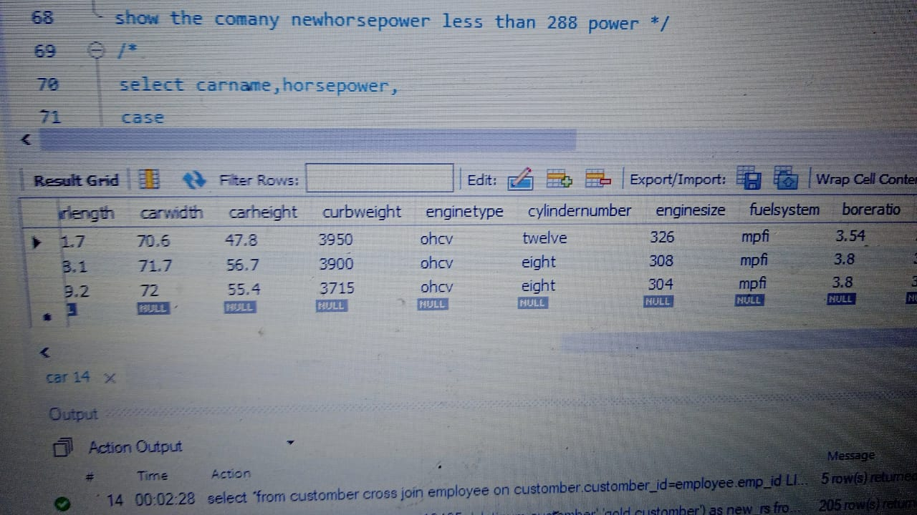
Question 9 show the data max engine size top three

Slide 11
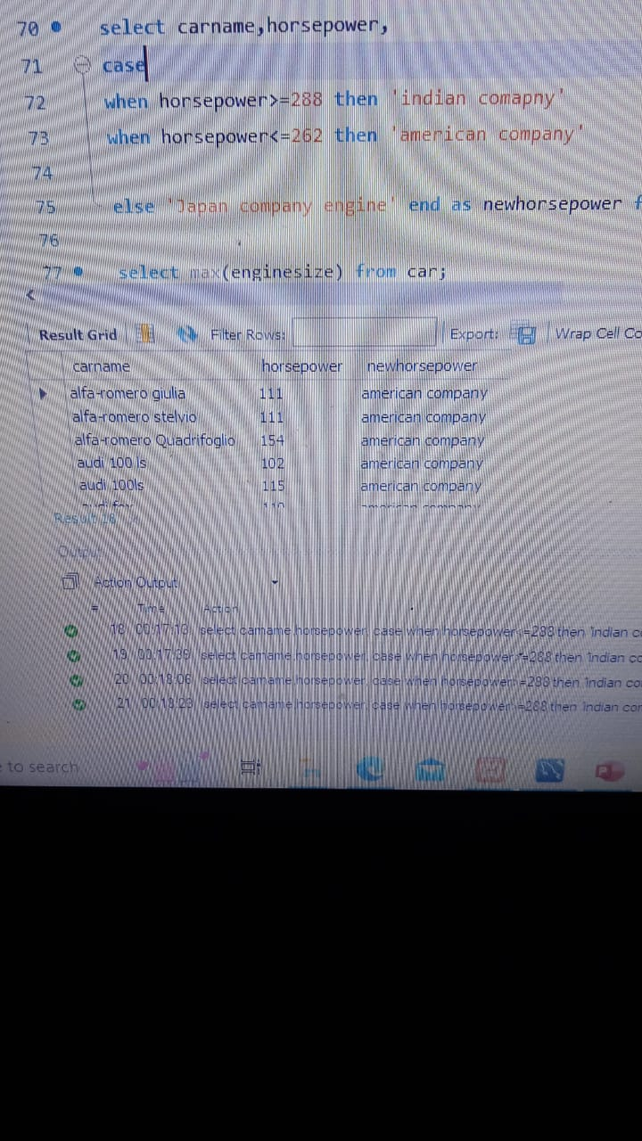
Question Number 10 show the comany newhorsepower less than 288 power case condition use

Slide 12
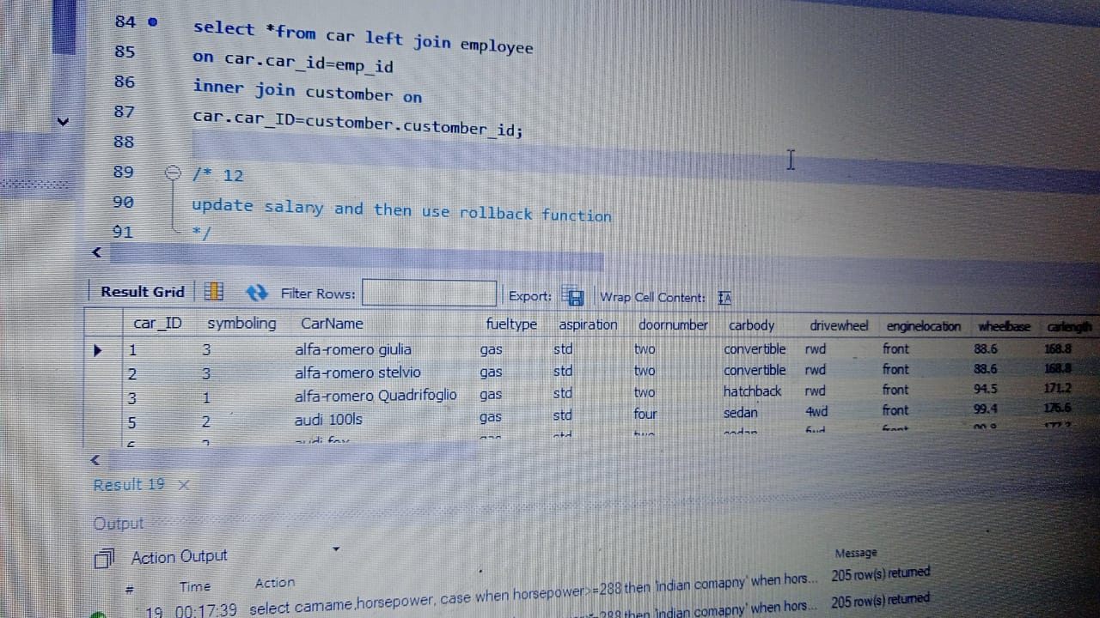
Question 11 Muliple Table Join show tha all idTable name car,employee,customber

Slide 13
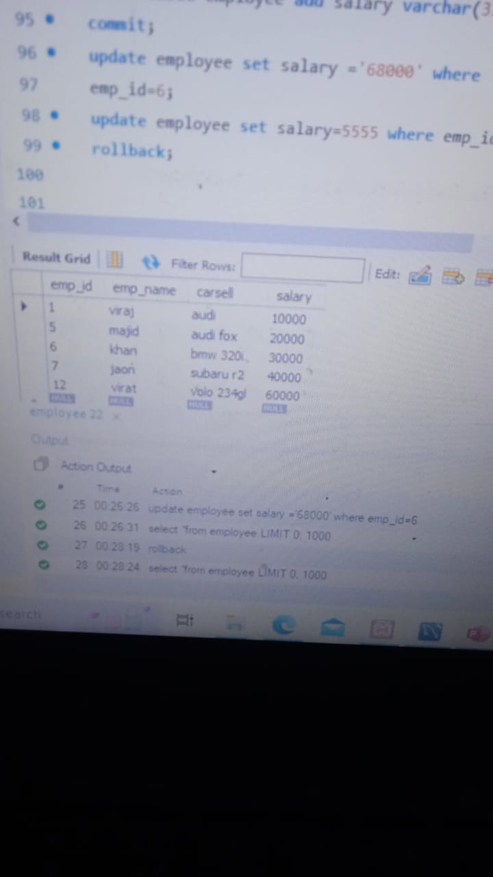
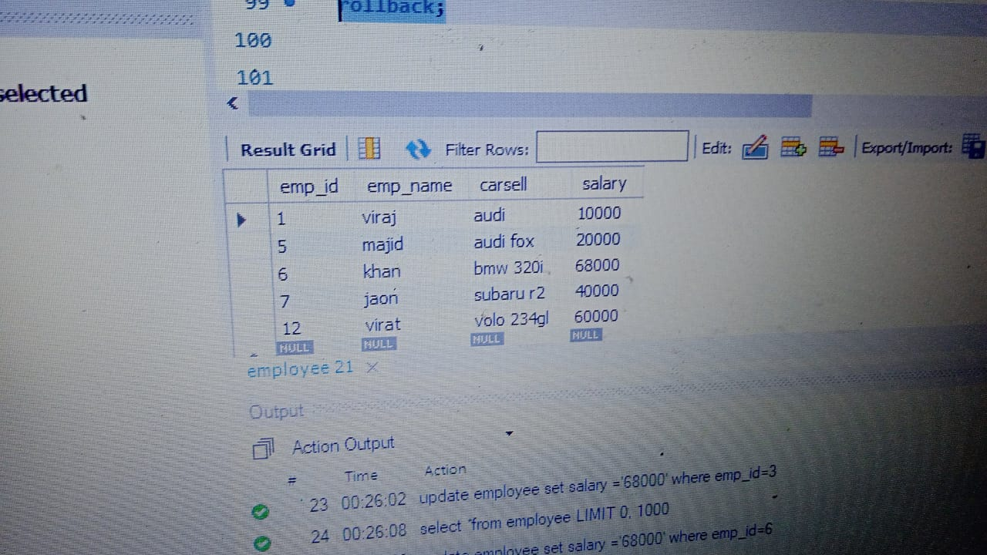
12 update salary and then use rollback function

Slide 14
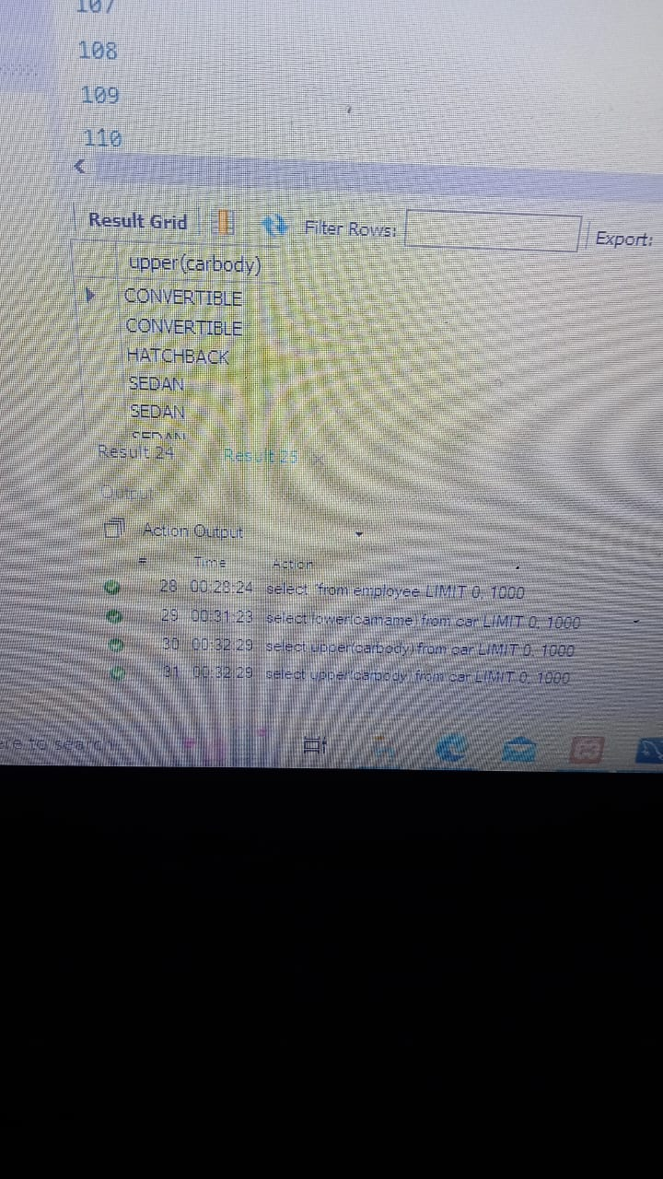
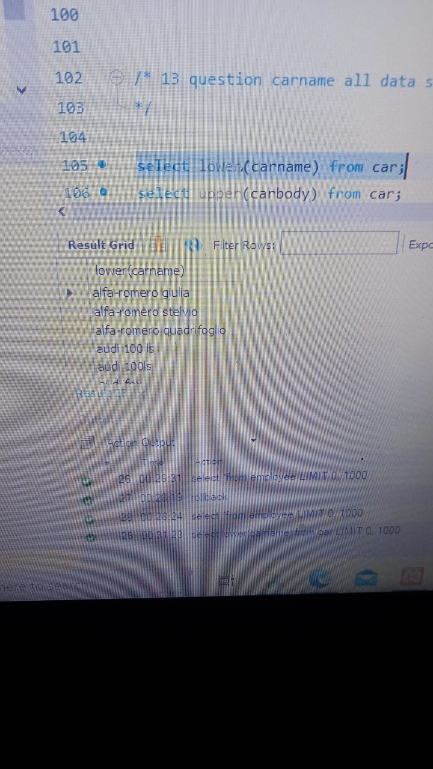
13 question carname all data small world and carbody colum capital world

